Slide 1
MCIS 3103 - Data Structure and Algorithms Day 4 – Search & Sort & Linked List
Spring 2020

Slide 2
Overview
Search
Linear Search
Finding Smallest Value
Binary Search
Sorting
Selection Sort
Insertion Sort
Linked List
Introduction
Insertion Sort

Slide 3
Searching
Searching is a process of selecting particular information from a collection of data, base on specific criteria.
Search can be performed on many different data structures.
Key – a unique value used to identify the data element of a collection.

Slide 4
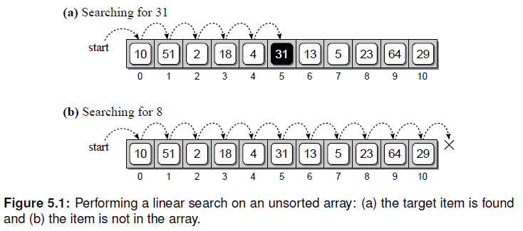
The Linear Search
This technique iterates over the sequence, one item at a time until the specific item is found or all items have been examined.

Slide 5
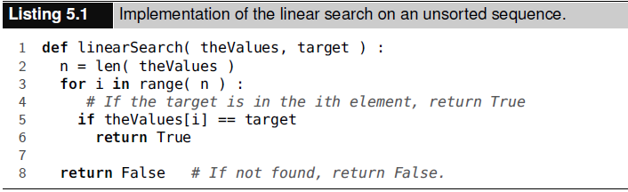
Finding a Specific item
If the item is in the sequence, the loop is terminated and True is returned. Otherwise, a full traversal is performed and False is returned.
Unsorted sequence example:
Worst case time of O(n)

Slide 6
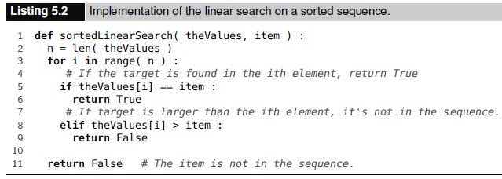
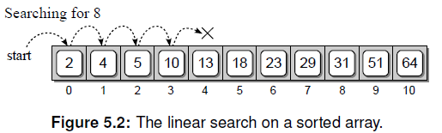
Searching a Sorted Sequence
It’s possible to terminate the search early when the value is not in the sequence

Slide 7
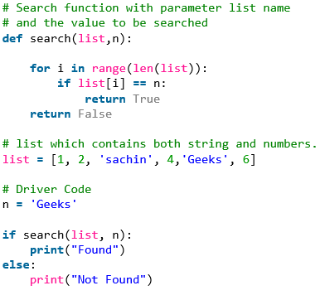
Linear Search Example

Slide 8
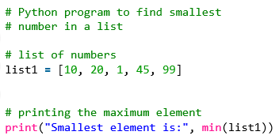
Finding the Smallest Value

Slide 9
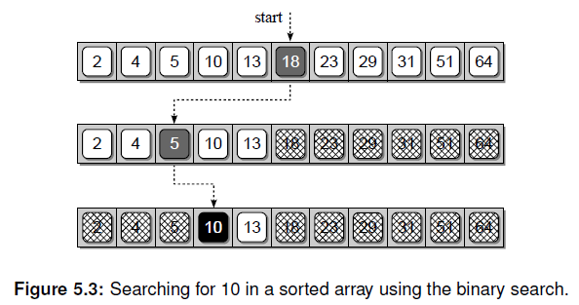
The binary Search
Divide and Conquer strategy, which entails dividing a larger problem into smaller parts and conquering the smaller part.
> Worst case time complexity: O (log n)
> find 10 from the array:

Slide 10
The binary Search

Slide 11
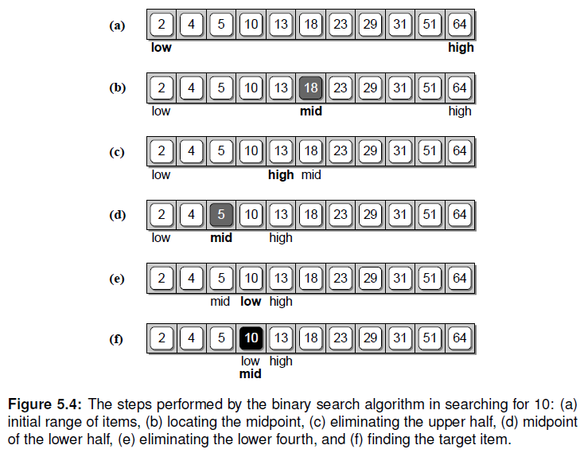
The binary Search

Slide 12
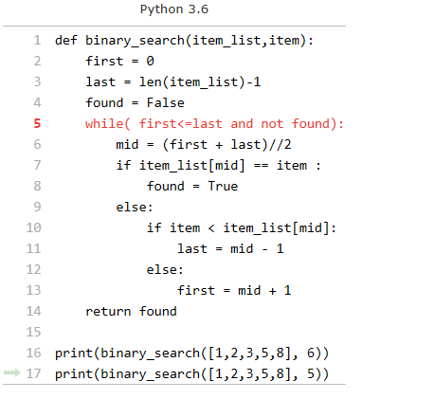
The binary Search-example

Slide 13
Sorting
Sorting is the process of arranging or ordering a collection of items such that each item and its successor satisfy a prescribed relationship.
Bubble Sort – arranges the values by iterating over the list multiple times, causing larger values to bubble to the top or end of the list.

Slide 14
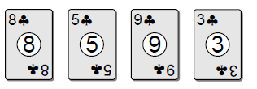
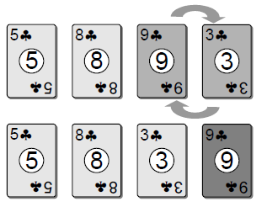
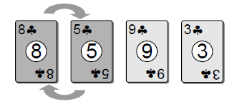

Bubble Sort

Slide 15
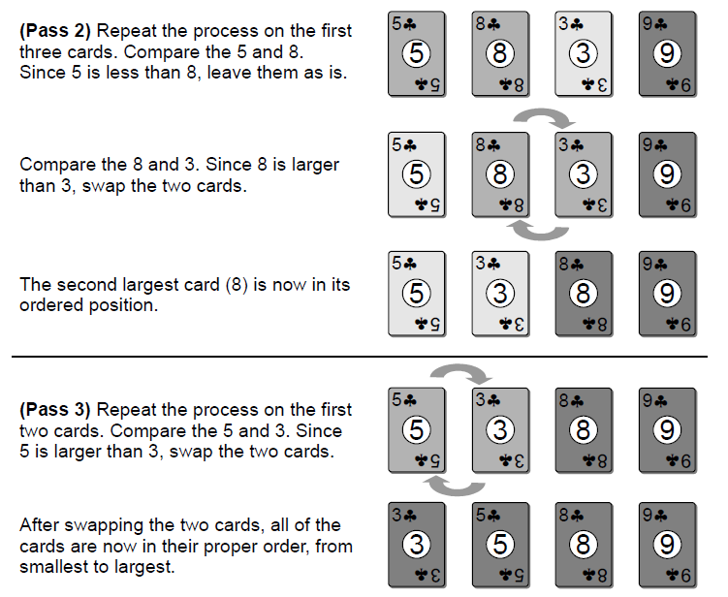
Bubble Sort

Slide 16
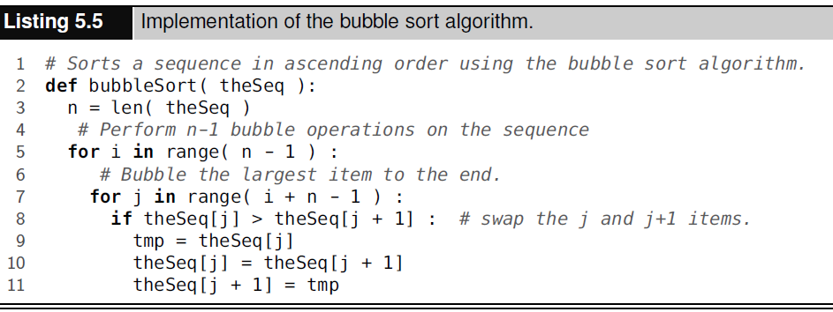
Bubble Sort

Slide 17
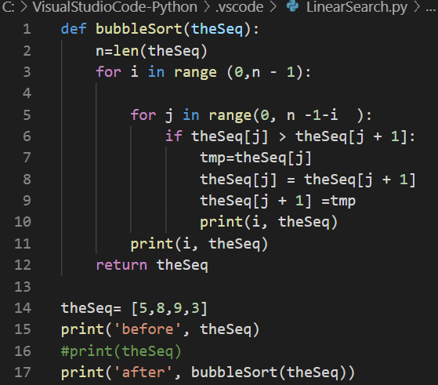
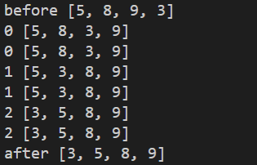
Bubble Sort

Slide 18

Efficiency of bubble sort
Depends on the number of keys in the array and is independent of the specific values and the initial arrangement of those values
Outer loop executed n-1 , inner loop executes n-1,
n-2, n-3 times until it executes the last pass.
Total number of iteration :
O(n^2)

Slide 19
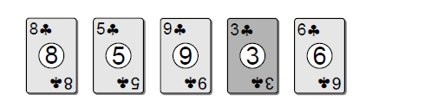
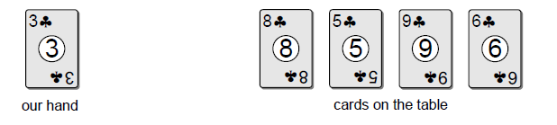
Selection Sort
Improves on the bubble sort
Selection sort – instead of swapping the card, select smallest from among those on the table and place it in our hand.

Slide 20
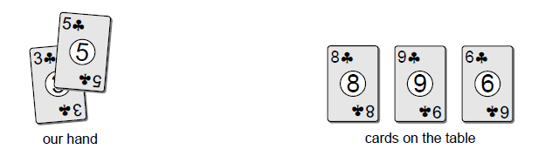
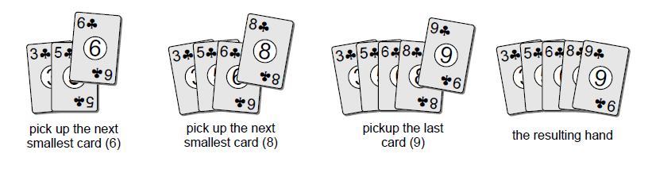
Selection Sort

Slide 21
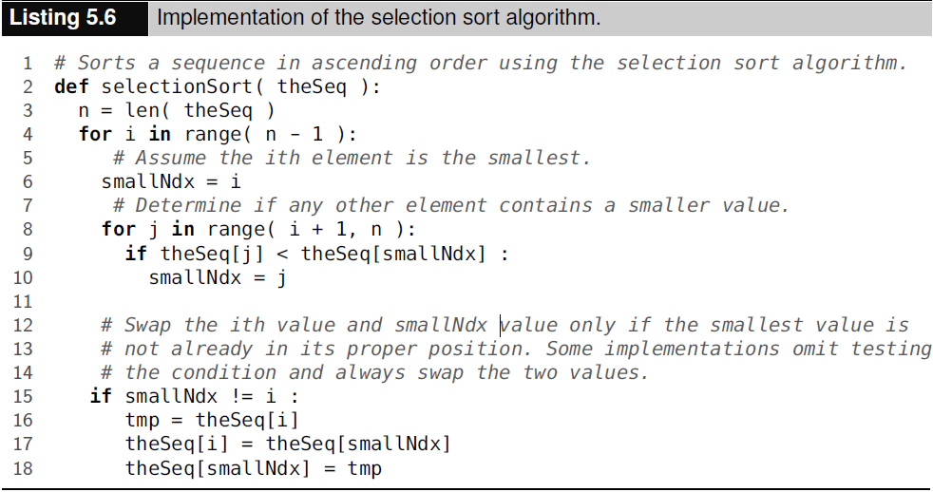
Selection Sort

Slide 22
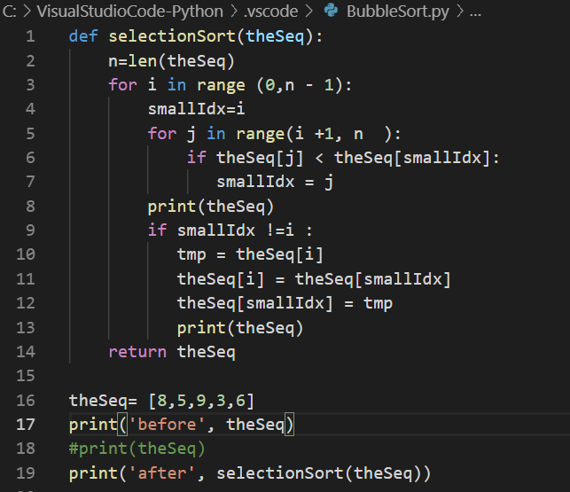
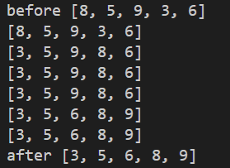
Selection Sort

Slide 23
Print memory address in Python
hex(id(curNode))
def traversal ( head):
curNode =head
while curNode is not None:
print (curNode.data, end=' ')
print (hex(id(curNode)))
curNode =curNode.next

Slide 24
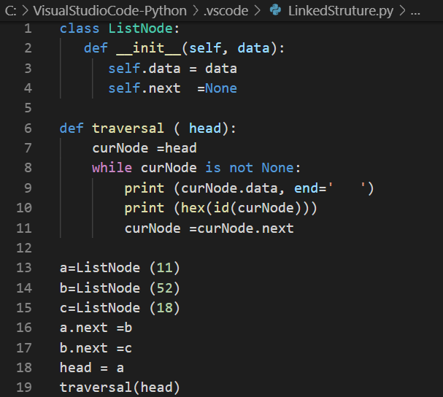
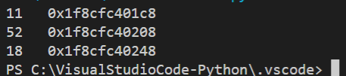
Print memory address in Python

